Slide 1
Alcohol and other drugs

Slide 2
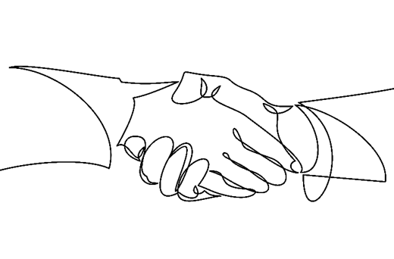
About the project
OPEN’s interest came from previous research projects
In partnership with Shetland Alcohol and Drugs Partnership
Supported by IDEAS fund
OPEN peer researchers (paid and volunteer) have undertaken project with support of professional researchers
Project managed by OPEN research team, made up of under 25s

Slide 3
Purpose of the research
From previous research : young people identified issues around drugs and alcohol, and the lack of alternatives
Impact: give young people the opportunity through our research to understand the impact of Shetland culture
Impact: give young people the opportunity to understand the impact of choices they make
Goals: improve services, reduce stigma, and raise awareness of cultural considerations
Notes:
-The purpose was to understand how Shetlands culture influences our young people and the choices they make. As researcher we wanted to gain a better understanding of what leads to regular use, what would help young people to avoid problem use and what young peoples support needs are around alcohol and other drugs.
-The aim wasn’t to ask young people what drugs they were taking or dig deep into personal experiences. We aimed to Identify why young people use alcohol or other drugs and whether the lack of opportunities and options identified within the OPEN Space project have an impact on young peoples choices.
- The project wanted young people to have the opportunity to understand the impact of the choices they make. To know if young people have the right tools and knowledge to make informed decisions surrounding alcohol and other drugs.
- Identifying ways of sharing tools and knowledge to young people in ways that they feel is valuable and suggested services that could do this.
- Our goal for this project is to identify gaps within services, reduce stigma and raise awareness of cultural considerations. For the Shetland community to value young people and to provide support and activity opportunities accordingly to meet the needs of our young people.

Slide 4
Method
The research methods used were:
Focus groups
Interviews
Online survey (anonymous)
Supported/enhanced by volunteer research activity (box and survey)
Approximately 215 young people have been involved in providing responses:
5 focus groups
7 interviews
Online Survey 176
Research team Participative Democracy certificates x 2 Rhiannan’s survey and Emma’s letter box.
14 people responded to Emma's box
23 people respondents to Rhiannan's survey. 19 out of 23 said they feel peer pressure
Notes:
This approach is intended to:
Improve education and understanding around substance use amongst service providers
Help identify the most impactful ways, and time to intervene
Propose solutions for meeting the needs of young people
Stimulate change and investment in the provision of services and support to young people

Slide 5
Scottish Government : Health and Well being census
What did the health and wellbeing census tell us?
 | Shetland | Scotland
Regular tobacco smokers (S2 and S4) | 4.9% | 2.7%
Use of e-cigarettes or regular vaping(S2 and S4) | 12.5% | 10.2%
Regular vaper (S2 and S4) | 8.2% | 6.7%
Drinking alcohol once a week or more(S2 and S4) | 14.4% | 7.4%
Have ever taken illegal drugs, drugs formerly known as legal highs, solvents, or prescription drugs that were not prescribed to you (S2 and S4) | 15.5% | 9.6%
Mental Health and Wellbeing – Strengths and Difficulties Questionnaire within normal range (S2-S6) | 64.3% | 58.1%
Mental Health and Wellbeing – My life is just right | 59.2% | 58.8%
Notes:
While we were already having our purpose for starting our project confirmed through our work these stats backed up the need for our work. Its great that the census can confirm what young people are doing, however our work was looking more at our culture, how it influences and impacts our young people and why young people choose to use alcohol and other drugs.

Slide 6

Findings

Slide 7
Alcohol and other drugs in Shetland
How young people view the culture in Shetland around alcohol and other drugs

Slide 8

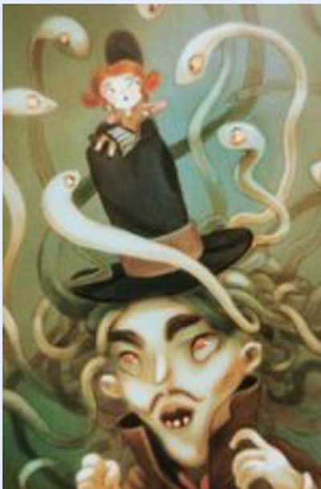
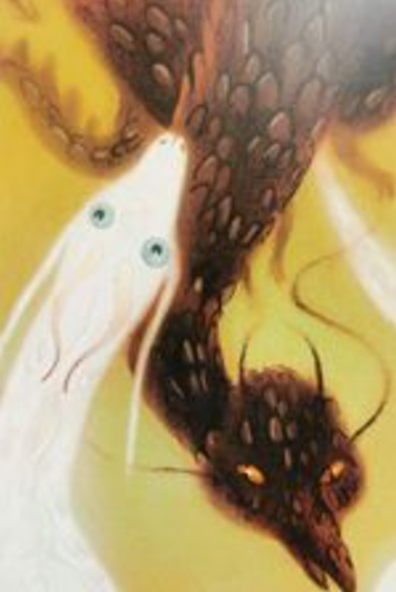
Our Survey
In our online survey young people were asked to select one of three potential images which they feel best describes culture. We had 176 respondents to the survey which targeted under people under 25. Surveys were circulated on social media and in schools.
Notes:
Image number 2 was our most popular image chosen by respondents. Image 3 was the next most likely image to be chosen

Slide 9
16 % of all respondents picked image number 1 from the Survey.
Interesting things they said
“because the sun is like its a good thing but the moon can be the bad side of it” – 14 -15 years
“Because it’s “hidden” because everyone pretends the drug problems don’t exist” – 14 -15 years
“I feel like the other images depict the drug and alcohol problems in Shetland as dangerous and bad but I feel like they are not as bad as you don’t notice drug crimes happening often in Shetland” – 16-17 years
“Drinking is something we do at night” – 16 – 17 years
“Cause drinking is normal up here” -14 to 15 years
Notes:
The moon and sun image, the first image option in the survey was chosen by 16% of respondents, this image seemed to be associated with night time use, the normality or frequency of use that young people experience and the hidden away aspects of alcohol and other drug culture. Respondents had a generally neutral or balanced response to this image.

Slide 10

“I think because its become so secretive and they just talk amongst themselves and its all new and different to them it seems fun, and it does when I was young it was fun but as I get older u realised this is just a no no. In moderation for sure”
“Drug testing might reduce use for a bit but it would make people more secretive.” “its constant, the thing is everybody's conversations is, what are you doing at the weekend?”
“A lot of people rely on alcohol, more than you think”
“You need affordable activities and stuff for people to go out and do like you can have lifeboats day.”
“Not necessarily like, actual peer pressure of people pressuring you, being like, oh should do this, but more peer pressure of everyone else is doing it.”
“That comes in the boredom side of it. If there was more stuff to do for more people interests, that would be helpful, but then I guess, as well, it’s reminding people that you can’t actually socialise with your friends without having a drink or taking drugs or whatever.”
“I say recreational use I think its totally fine. I don’t think it’s a bad thing for people to drink at a young age. In general, I did it and I turned out okay, I guess.”
Perception of image 1 and quotes from interviews and focus groups –
Notes:
Balance: young people feel that there is a good side and a bad side of alcohol and other drugs. Within the survey participants who chose image 1 mostly felt neutral towards Shetlands alcohol and drug culture.
Alcohol and drugs seem to be taken at night-time, the culture centres around evening and night-time drinking. They feel there is a lack of events not based in alcohol and other drugs.
Use generally is hidden , its done during the evening or during the night.
Reflects the normalisation of use within Shetland culture

Slide 11

52 % of all respondents picked image number 2 from the Survey.
Interesting things they said
“The person is in need of help” – under 14 years
“The snakes that were surrounding the person on the hat show how easy it is for drugs to put you in vulnerable position in life” aged 16 -17 years
“If you choose a bad group of people to hang with your like the person in the middle getting pressured by the others around” – 14-15 years
“It looks like someone being pressured by drugs and alcohol” – under 14 years
“The thing on top of his head is controlling like drugs control people” – under 14 years
“Person on hat is surrounded by serpents, just like those who choose not to partake in drinking or drug use are” – 21 to 24
“It displays the madness that ensues”. – 25 years plus
“it looks like a young person is being forced to do something” “young people doing drugs now a days are forced to and get addicted.” – under 14 years
Notes:
The snakes surrounding the mans head was our second image option in our survey and was chosen by 52% of respondents. Respondents felt described darker connotations for this image, speaking about the vulnerability associated with use, cultural and peer pressure.

Slide 12

Perception of image 2 and quotes from interviews and focus groups –
“I got involved with the wrong people in Secondary 3, the wrong type of people.”
“Peer Pressure, because I do think, everybody like you hiv the popular people in school and they're all drinking, there were all drinking at like 14, so you start drinking because that’s whit there doing and your trying so hard to fit in at school because there's this pressure coming fae like every angle that you hiv tae fit in. So you start drinking.”
“It’s an issue when you personally don’t want to do any kind of drugs or alcohol but all your friends do and you kind of get left out or they just start ignoring you. That’s real.”
“I think like if people like parents or like so many other people didn’t have such bad views on it then like people wouldn’t struggle so much to get help when they do start getting into a problem.”
Notes:
- The theme of vulnerability was a key theme for this image. Backed up in focus groups and interviews. Young people can identify the vulnerable people who use alcohol and drugs can encounter and recognised that this is a barrier.
- Peer pressure has been touched on multiple times, peer pressure was mentioned 14 times during our focus groups and interviews. Young people feel that they are ostracized from friend groups for not joining in, which has a knock on effect to young peoples wellbeing.
- Young people are aware of the bad/dark side of alcohol and drug culture and feel wary of it.

Slide 13

32 % of all respondents picked image number 3 from the Survey.
“because its like people who take drugs and who don’t” – under 14 years
“it looked like snakes and people often sliver away to get drugs or drink alcohol” – under 14 years
“because it looks life there's one bad dragon and one good one and some people can be bad after alcohol and drugs and some can be good” – under 14 years
“it shows the two types of drug abuse in Shetland” – 14 -15 years
“There is a light side and a dark side, light side being good times, fun with friends, making memories but there is definitely a dark side, alcoholism is covered up and nobody questions it when people start drinking or taking too much stuff until people are too far in and then they are just faced with stigma. Though there are many people who you would never guess have problems with drink and drugs but manage to cover it up” – 21 to 24 years
“Cause it looks more crazy, and I feel like drug taking in Shetland has gone crazy. Literally everyone is doing it” – 18 – 20 years
“Because there's still drug use but its hidden” – under 14 years
Notes:
The white dragon and black dragon was our third image option in our survey and was chosen by 32% of respondents. Generally this image was perceived similarly to image one but with more respondents speaking about problem use.

Slide 14
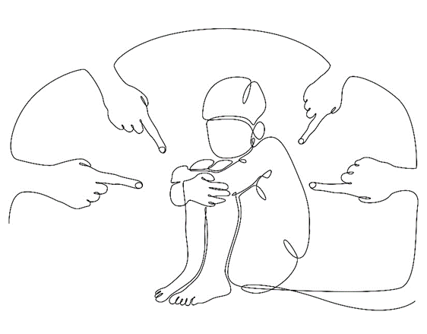
Perception of image 3 and quotes from interviews and focus groups
“People are so black and white about it” “People wouldn’t be so addicted to drugs if they were feeling amazing in themselves”
“I think there's good things to drinking and I dunno going out and socialising bit it’s the fact how drunk everybody gets up here.”
“Like literally people come from being like I dunno there was tourists up from America and they were trying to keep up with the locals and there were black out – do you know what I mean?”
“I have a lot of friends that are definitely like in denial of the fact that they, they're , they are addicted” “They're functioning addicts like they can go to work but like they're doing it every night.”
“If I felt like I could have gone and spoken to my friends mam ( addicted friend) then I would have but the fact is that it would have probably just sent them deep, deeper hole and they might have ended up kicked out it could have made it just so much worse whereas if people were more understanding that yeah people end up taking drugs and that’s fine that happens, like your young. As long as they stop eventually.”
Notes:
- This image seemed to bring more reflection from participants about balance, good and bad, ying and yang. Similar to image one but with more emphasis on problem use.
- This image brought forward more negative observations about Shetlands culture and the negative impact of the culture in young peoples lives.
- Stigma attached to usage, everyone wants you to come to the party until you develop a problem, then feeling pushed out by their own community.

Slide 15
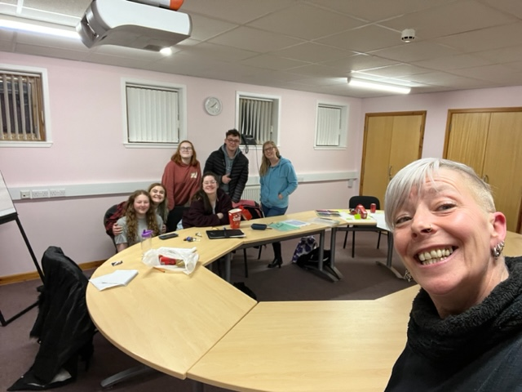
Participative Democracy Certificates
Research methods and number of respondents used for PDC’s.
Picture taken from research team meeting. Volunteers carrying out research tasks to plan for their PDC’s
Notes:
Two members of our research team carried out their own research tasks during the Alcohol and other drugs project to complete their participative democracy certificates.

Slide 16
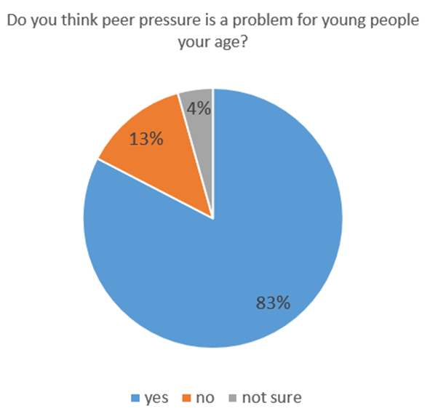
Rhiannan’s Survey
Do you think that peer pressure is a problem for young people your age?
19 out of 23 respondents to the survey said they feel peer pressure.
Notes:
Rhiannan chose to make an online survey asking young people Do you think that peer pressure is a problem for young people your age?
19 out of 23 respondents to her survey said they feel peer pressure.
One of respondents feedback :
“I am sure but I want to elaborate. I do see particularly in young men that they egg each other on to take silly amounts of drugs and alcohol, but there’s also that unspoken peer pressure. Maybe nobody is forcing you to drink or take drugs but you feel like you have to because everyone else is.”

Slide 17
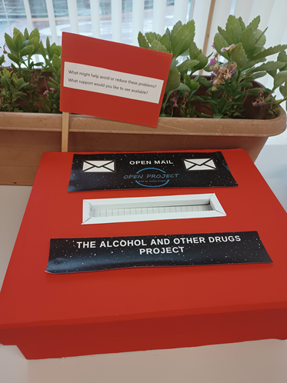
“What might help avoid or reduce these problems?” “What support would you like to see available?”
The quotes below are her findings.
Educate adults as well as children, Reduce the normality of drinking
I want to be able to talk about drug dependency without it being a bad thing
Educate the youth but also educate adults (parents)!!
Non judgmental and confidential people to talk to / 1 to 1's
More support or acceptance in aspects of having an addiction rather than shaming it
Notes:
To conduct her research Emma created a mail box. Asking her peers :
“What might help avoid or reduce these problems?” “What support would you like to see available?” the key feedback from respondents told us was ; The need for more options, education for adults surrounding alcohol and other drugs, stigma, reducing supply distribution and more education for youth.

Slide 18
Summarising the findings
Alcohol and other drugs are intertwined with wider Shetland culture, and are the only way to join in
There is widespread acceptance of use, but problem use is frowned upon or ignored
There is no single reason why people use alcohol and other drugs
There are differences across young people and locations
Notes:
- Our survey, interviews and focus group research with young people has created an interesting and compelling picture of the alcohol and drugs culture in Shetland.
- Several recurring themes emerged from across our different research methods, alongside some specific or differing perspectives on certain issues, such as is the culture ‘bad’ or ‘good’.

Slide 19
Alcohol and other drugs are intertwined with wider Shetland culture, and are the only way to join in
“Something to do other than drinking because I think the crux of the issue that there is hardly anything to do other than drink on the weekend and I think like there’s no way to tip toe around that.”
“Everything in Shetland has got to have some sort of alcohol involvement, Up Helly Aa, Big Bannock”
“But as young adult, there nothing else to do if you want to socialise, its going to involve alcohol pretty much.”
“Alcohol fuelled socialising is regarded as normal/good and “drugs” bad. Alcohol is not regarded as a drug.”
“You know people might recreationally smoke a little bit of weed or that during the week, on the weekends when they’re out drinking they might take a little bit of other substances, cocaine, whatever and it could just be to be to help fuel their party or whatever but could that be reduced if there was other things for young people to do? Definitely I think so.”
“Alcohol is huge, massive, like everyone up here there’s a lot of people drinking all the time, every weekend.”
Notes:
- Young people feel that there is a cultural pressure join in alcohol and other drug related activities, they feel its impossible to avoid with alcohol being everywhere.
- The lack of options or alternatives adds to the cultural pressure and have described that if there was more nightlife and weekend opportunities away from the alcohol and other drug culture.

Slide 20
“There’s so much peer pressure to take drugs and to drink - Shetlands drinking culture is really hard to be in when you don’t drink alcohol cause you’re seen as boring if you’re not getting drunk every weekend”
“There are lots of people who do drugs and alcohol who are under aged”
There is widespread acceptance of use, but problem use is frowned upon or ignored
“I think the problem is that its just there, its easily accessible.”
“turning a blind eye. not my business attitude”
“It’s a hypocritical as it doesn’t see alcoholism and drinking to access an issue. Drug users and those in recovery are not supported enough by the community.”
“I think that quite a lot of young people in Shetland do drugs and drink alcohol because since Shetland is quite a small place then its really easy to find out who sells stuff”
Notes:
- There is a spectrum of use within Shetland that has been described by participants. We know from our findings that young people feel that Shetland culture is not all bad and while there is underage use that it could be worse.
- Young people identified the stigma surrounding different levels of use, the its okay until its not okay mentality.
- Young people feel problem use is judged but that there is a level of acceptable use that isn’t judged and the line between the two is a fine line but that we as a community choose to ignore this, young people feel not enough is being done.
- Young people told us that alcohol and other drugs are accessible and easy to get, but on the back of that they feel they are less likely to look for help if they were concerned about their own or others usage.

Slide 21
“Young people drink at the weekend because they’ve got fuck all else to do – put something on for them.”
“I feel like people do it often here because of boredom”
There is no single reason why people use alcohol and other drugs
“…You know, young people are seeing the adults, do what they do. And up here, it’s not just young people that are out in that was. A lot of it is adults. And they're the ones that have been doing it for so long that maybe has become problematic, you know. And then there's the ones that are still enjoying recreationally in order they hide it because they have to obviously so they don’t even see the people like healthily living their lives that way.”
“Its like kinda the drinking culture up here, we have a drinking culture that’s for sure, but it’s the two sides that’s really extreme like alcoholism and then there is just the having a drink cause your stressed after work which is still apart of drinking culture.”
Notes:
- Young people have identified that there is no single reason for use, peer pressure and cultural pressures have an influence in young peoples choices to use alcohol and other drugs but they feel as though the lack of options means they really only have one option at the weekend.
- Adults are seen to be having fun at the pubs or partying which young people aspire to also, young people have told us they want to be shown ways of enjoying life outside of the alcohol and drug culture.

Slide 22
“I'd say alcohol is a big issue surrounding young people as they feel maybe it’s a way of enjoyment as Shetland lacks some major enjoyment places the young people can go and I feel like drugs are a problem only to people who involve themselves in drugs”
There are differences across young people and locations
“everyone knows at least 10 people who do drugs and/or alcohol
“Some bits are good some bits are not.”
“I don't think its good because a lot of people in Shetland is in trouble when they take part in alcohol and drugs”
Notes:
- The survey gave us a range of responses when we asked young people to describe alcohol and other drug culture in Shetland from some bad, some good and others telling us they didn’t know about the culture. Some young people have a balanced and good perception of our culture while others feel the opposite.
- Our data told us that young people feel location plays a role and that alcohol and drugs is worse in Lerwick compared to out in the country. From the comments that tell us that they don’t know we can presume because of this that the culture hasn’t been on their radar enough to say concern or praise on the subject for themselves but also tells us that maybe these young people are unaffected by this subject.

Slide 23
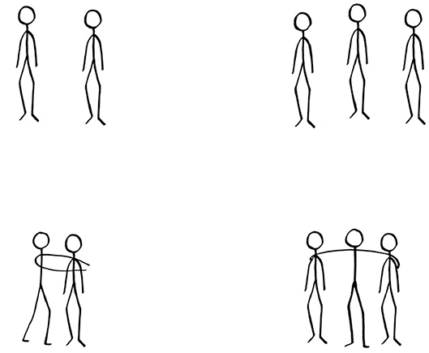
The Impact

Slide 24
The impact of alcohol and other drug culture in Shetland
In this section, the views of young people on the impact of the alcohol and other drugs culture in Shetland are described under the following headings:
-Negative experiences felt due to a widespread stigma throughout Shetland, problems being ignored and how the community impact affects young people
-Impact on Young people’s development and on their personal safety. Health repercussions relating to lifestyle.
-Impact on mental and emotional wellbeing and relationships.
Notes:
Our research methods gave us a wide range of knowledge about the impact of Shetland's alcohol and other drug culture on young people. While what young people told us is mainly negative, it does show how young people’s wellbeing is impacted drastically.

Slide 25
“I have a lot of friends that are definitely like in denial of the fact that they are addicted.” “they’re functioning addicts like they can go to work but like they’re doing it every night.”
“They’ll take drugs they might not even have any problems in their life but they’ll take drugs, then their mood goes down and they’ll become more dependant because it’s the only thing that keeps them happy its because they’ve trained themselves to be happy about.”
Impact on mental and emotional wellbeing and relationships
“Pressure, mental health, once your in that circle its hard to get out of it as they keep you in”
“So yeah, I think a lot of it has to do with socialising but also what support is there? I know so many people that use it as an escape, some people are just unlucky to fall down that rabbit hole a bit too much. Because they don’t have that support. ”
“Not knowing the danger and then overdosing you wid go oot and youd get absolutely blootered, black out, spew everywhar mak a fool of yourself because you didna keen whit wis gunna happen.”
“I think you find your true friends who really wanna spend time with you when your no going oot to the pub.”
Notes:
- We know that mental health and emotional wellbeing plays a role on why young people might use alcohol and other drugs, young people have demonstrated an understanding of the negative repercussions of use on mental health.
- Young people identified that spiralling use or problem use usually begins as a coping mechanism and that these coping mechanisms usually lead to unhealthy relationships that are based around alcohol and drugs.
- The lack of healthy relationships, spiralling use and the impact on young people’s mental health and wellbeing all leads to an increased vulnerability for those experiencing these issues

Slide 26
When their health like gets really bad after all the things they’ve been doing with alcohol and drugs.” “Police.” “Car accidents.” “Whoo it goes down”- speaking about how much money you have, that’s a “bad” thing. “robbery”
“People our age haven’t got fully developed brains yet and its like its really harmful even if you just do it once it can really mess you up for the rest of their life.”
“drugs are a waste of money”
“When you are having money troubles because of it.”
Young people’s development and their personal safety. Health repercussions relating to lifestyle. Finance.
“When it affects their physical health as well like losing family members could be relationship breakdown but it could also be them dying because of it.”
“I’m even thinking because I know people that have really good life prospects, but they’re all taking coke all the time. And like I’m thinking someone in particular, they have a really well- paying job, like they literally could have paid off a house by now. But they have absolutely nothing to show for the money that they’ve been earning since they were 18 on, which I think is so sad and they don’t see no problem with it.”
Notes:
- Physical development being impacted was something young people were concerned about with an emphasis on how alcohol and other drugs affects brain development.
- Financial hardships were identified; the impact of this to someone already experiencing problem use has a knock on affect to their wellbeing and mental state.
- They told us that personal safety is at risk when young people are in environments where they are not protected, behind closed doors in houses, risky behaviour is seen as normal as they do not see or feel other routes available to them

Slide 27
“This is kind of a situation but like when all your friends do to because they know you will take care of them but then they’re using the fact that you will take of them to do dangerous acts.”
“If you don’t drink or do drugs then sometimes you’ll just lose a lot of friends.”
“It’s an issue when you personally don’t want to do any kind of drugs or alcohol but all your friends do and you kind of get left out or they start ignoring you.”
“Something needs to be done about stigma.”
“So like doing it because everyone's doing it.”
Young people believe the negative impacts are made worse by problems being ignored, stigma, and peer pressure.
“Just like I seem to hear a lot about this person or that person. And it’s always at the moment, it seems to be coke and heroin. Yeah, well, mostly crack and heroin, which is pretty bad, because everyone gets bored of coke, and then they go up to crack.”
“There is a light side and a dark side, light side being good times, fun with friends, making memories but there is definitely a dark side, alcoholism is covered up and nobody questions it when people start drinking or taking too much stuff until people are too far in and then they are just faced with stigma. Though there are many people who you would never guess have problems with drink and drugs but manage to cover it up.”
Notes:
- Young people feel that the peer pressure to take part is strong, young people told us that if they don’t take part in alcohol and other drug use that they feel ostracized or that they end up being the sober friend having to look after their drunk peers.
- The stigma in the community surrounding the topic makes broaching the subject difficult for young people if they want to talk about issues they are experiencing. Young people, having to look after intoxicated friends, the possibility of being experiencing criminal behaviour and complained about the litter in the town after weekends, feel the knock on impact within the community.

Slide 28

What young people want
Ideas for change suggested by young people to improve Shetlands alcohol and drug culture.

Slide 29
Ideas for change suggested by young people to improve Shetlands alcohol and drug culture
In this section, young peoples views and opinions of improvements that are needed in Shetland are described under the following headings:
-Change is needed to normalise asking for help and to reduce stigma
-More access to diverse ranges of support and education to reduce the appeal of alcohol and other drugs.
-The need for diverse opportunities to provide more choices for young people and the need for positive mentors to model these lifestyle choices
-Open and honest conversations in families, relationships and communities
Notes:
The purpose of our work was to find out why young people would choose to use alcohol and other drugs. Young people told us a compelling number of suggestions that would improve how they perceive and experience Shetland culture; we have pulled these ideas for change from our focus groups, interviews and survey. Young people would like to see a diverse range of different things offered and feel there is a real need.

Slide 30
Change is needed to normalise asking for help and to reduce stigma
“But like I just think as a whole society up here, maybe need to be more open about it. You know, parents maybe need to be more open with their children and not get mad at the idea of speaking about drugs and alcohol. Have an open space or not even necessarily parents but carers as well, but having that openness to be able to talk about it with your trusted adults because I think it would create more safety for younger ones when they are in a shitty situation.”
“Reduce stigma – being able to talk about it and learn from others without being judged because of it. Being able to get help without fear of being judged for it.”
“My Magic wand would wipe all the narrow mindedness away from the older generation to stop so much judgement surrounding young people and Alcohol and Drugs. As the older generation were not all saints and need to stop acting like that. Alcohol and Drugs is a massive part of Shetland and Young people need to have a place to take without judgement and fear of being a child protection issue and having social work involvement.”
“Make it so any young person using drugs should be able to speak to someone they trust about it and 1) get the help they need and 2) not be judged.”
“More support for people struggling without others/ services getting involved.”
Notes:
Change is necessary for things to improve. Stigma needs to be reduced so that young people can ask for help without fear of judgement. Normalising asking for help so that people can access help when they feel they need it, which could possibly mean that people are more likely to seek early intervention or themselves.

Slide 31
More access to diverse ranges of support and education to reduce the appeal of alcohol and other drugs.
“Have effective and realistic lessons in education so people can do drugs safely, but of course if they are going to do so we should discourage it.”
“A place that doesn’t close past 5pm would be spectacular”
“There’s a problem up here because it’s all relied on the common people, that’s why we have groups like OPEN and the recovery hub because the police up here aren’t doing enough.”
“Definitely better mental health support.”
“I really believe in like the power of information, I don’t like scare tactics, because that doesn’t work.”
“Walk in support – when you need it you need it now not in two weeks’ time.”
“Anonymous online groups as Shetland is too small for face to face groups and it would put people off going due to the fact someone they may know there is someone might tell others that they were there.”
“I would make it a priority to offer them a specialist worker for them to be able to speak to about anything and to get them the help they need.”
Notes:
- Young people told us that there is a need for diverse opportunities within our community so that young people can nurture skills that they may not be able to explore currently.
- A call for a variety of education both to provide options for young people to expand their knowledge in subjects that they may not currently have access to and having space to nurture new interests.
- Education about alcohol and other drugs has also been something we have heard often in our work, scare tactics don’t work but young people praised harm reduction education. People with lived experience delivering harm reduction education whilst also sharing their experience was something young people felt would decrease incentives and be a valuable education tool, which in turn would eradicate the myths surrounding the subject.
- A variety of support options was also something we were told repeatedly. Young people suggested a range of support methods such as online support networks, person centred support, individual 1 to 1 support with trusted adults, crisis support, peer support.
- Young people also flagged the need for aftercare in Shetland.
- A couple young people told us they wished for a world where everyone was sober but nearly every young person told us in one way or another that they wanted sobriety to be the norm not the exception

Slide 32
The need for diverse opportunities to provide more choices for young people and the need for positive mentors to model these lifestyle choices.
“I think that people just from my experience in Da Café there’s so many young people that have amazing skills, so there’s a young lad that bakes that should be promoted in terms of like he wants to set up a baking class where after school one day just a group of them that’s interested can go and do that somewhere. One of the girls at Da Café does woodwork, makes furniture and she’s really good at it, I’m sure she’s not the only one.”
“More money to go towards shit.”
“I was going to say there should be more Saturday jobs available or jobs after school. Yeah flexible working.”
“I think trying to challenge that outlook on it would probably be the best bet to a positive change because I mean if you can challenge that you can effectively change the perception of that then that’s one of the big steps to change.”
“It’s just having those facilities available outside of school where if a student is particularly passionate about something they can go to that space and do it without feeling like I’m missing out because it’s something they’re passionate about.”
Notes:
- The importance of choices was discussed often between young people. As touched on in previous slides the lack of opportunities is felt by young people. They expressed that they want more work experience opportunities and more job opportunities.
- Young people told us they want regular, affordable or free spaces that allow them to run their own activities such as baking, arts, music, different types of sports and learn new life skills.
- Young people want to try new things with adults demonstrating how to have fun and find fulfilment in their activities, showing how to nurture wellbeing outside of the alcohol and drug culture, not just seeing adults enjoying themselves at alcohol based events.

Slide 33
Open and honest conversations in families, relationships and communities
“If I could wave a magic wand it would be that everyone had at least one person that they could go and speak to about these things and trust and be open and honest with. Because I feel like a lot of the time when you hide it you’re not speaking about it, you’re not realising how bad it is or like how much of a problem you’ve created themselves sort of thing.”
“That I think it really everyone's views would need to change not just young people but like, everyone as a whole, you know, young people are seeing the adults, do what they do... And they're the ones that have been doing it for so long that maybe has become problematic, you know... so they don't even see the people like healthfully living their lives that way.”
“Tell adults that their childhood of excessive drinking and doing drugs was not normal. Tell young people they won’t get trouble for asking for help.”
“I just think more conversations about what is healthy, what’s not… And also like, what other stuff could be done. Not even surrounding that drugs and alcohol just like there is other stuff to do...” “But yeah, conversations.”
“I think for like a culture shift, it’s really everyone who has to be involved in that. You know, I mean and like that’s a big task to do.”
Notes:
- We know at the heart of the ideas for change that young people told us that the want to have open and honest conversations in families, relationships and communities.
- Young people feel mostly Shetland culture revolves around alcohol and other drugs, they feel that the problem does not lie with them but the wider community and that tackling the cultural influence that young people have identified is a shared responsibility.
- A collective and personal responsibility to take accountability for the behaviour patterns that influence us, young people are keen for our community to challenge the current stagnated conversation around the topic to instead have open and honest conversations to work towards this which everyone needs to commit too.

Slide 34

Researchers Observations

Slide 35
What Surprised Us?
Young people have a good grasp and how insightful they were surrounding the issues alcohol and other drug culture.
Young peoples readiness to share suggestions or ideas
Young people want the whole community to work together to solve issues the community faces.
Young peoples suggestions for options for change or improvements they would like to see are not centred around alcohol
Notes:
Young people are very aware of the issues affecting them and they never hesitated or struggled to be able to come up with ideas and suggestions, it was surprising to me how open young people were to the fact that there were issues with everyone and that everyone could be a part of the change that helps to improve the situation.
It was surprising how keen young people were to see things that they were able to do that did not have alcohol involved or were not centred around alcohol. They were able to give a huge list of the opportunities they would like to see available.

Slide 36
Key Issues To Consider
Young people know that the problem doesn’t lie with them but rather everyone.
The current situation can only change by working together and becoming an interconnected community
Opportunities for our young people to enrich their lives in a variety of ways.
Reduce the stigma surrounding asking for help
Notes:
- Young people are keenly aware of systemic issues and they are calling out for the help of the older and wider community to help them to find a new way to think and talk about alcohol and other drugs and to be able to create a safer environment for everyone to live.
- Young people want life opportunities and social opportunities offered to them out with the current situation and it is not for them to go out looking for this or create it.
- It is up to older people and professionals to offer young people these opportunities and to create options for young people to be able to further themselves and their lives without the pressure.

Slide 37
Lessons learnt
Creating and nurturing relationships and working together in partnership work has really helped our research. In future we would work to establish even more partnership relationships before starting the research project.
While we heard from approximately 215 young people and had data from every age group we are aware that with more time we might have been able to reach more young people.
Notes:
- Create better and ongoing relationships with different services before starting research so that when young people come up with research ideas then the staff team already have a vast range of knowledge and contact information of who is important to speak to for each issue.
- I think for a wide topic such as this and the actual real lasting impact it can have on young people that there is never enough time to be able to fully get everyone’s views the ideas for change.
- The young people involved came up with such varied and important suggestions that it has enriched our research and that every young person in Shetland has a voice which is worth listening to and their issues worth acting on.

Slide 38

Choose Empathy
“People can recover from it, if they’ve got the right people around them.”
Notes:
Personal stories can be helpful but it needs to be done properly and safely. James Docherty at an event that I attended talked about empathy.
- He spoke of walking into his close with his daughter and seeing someone who had taken too much and was lying on the ground unwell. James could either walk around this man and ignore him, or he could help.
James realised this was a teaching moment for his daughter and chose to help the man and make sure he had the help he needed. He knew whatever he chose to do would have a subconscious influence on his daughter and that choosing to ignore the man would feed into the stigmatising narrative that his daughter was likely to encounter in life and that choosing to help and act in empathy would hopefully be the moment his daughter remembered if she was ever in the situation.
Personally, this story has always spoken volumes to me, empathy and humanity should be at the heart of all we do, you do not have to be perfect to be a role model, you just need to consider your actions before you act.

Slide 39
Thank You

Slide 40
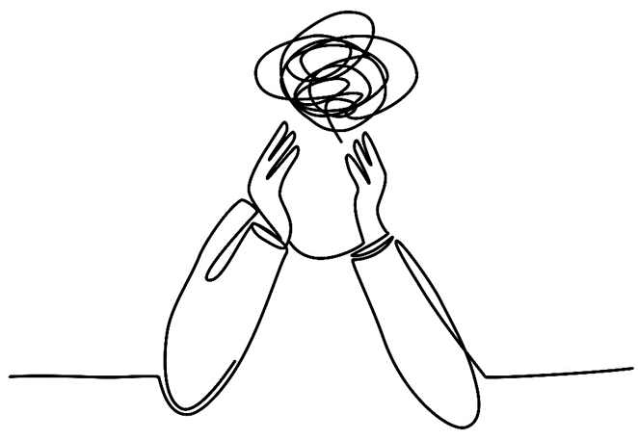
Respect and Language
Notes:
We are aware that in our findings young people were saying that there is differences across locations, however when we presented the findings to our volunteers they contradicted this saying that they feel things are just as bad in the country as in Lerwick, and wanted to flag this fact to anyone reading our findings.
The statements in this presentation are the opinions of the respondents that took part and we are aware that some of the information is the opinions of young people.
Our volunteers felt the need to highlight that the use of language towards substance use is the language used by participants is not the current recognised terms. While we want to maintain the exact quotes and views of young people we know this may be perceived as discriminatory.

Slide 41
Local and National Services
If you have been affected by any of the issues discussed in this or want to talk to someone for support these services are here for you :
Shetland Recovery Hub 01595 744402
Substance Misuse Recovery Service 01595 743006
National Alcohol and Other Drug Hotline 1800 250 015
Crew 2000 Digital Drop-in by emailing dropin@crew2000.org.uk, sending a FREE text to 07860047501 for a call back. For more resources search www.crew.scot/
Call 116 123 to talk to Samaratins , or email: jo@Samaritans.org for a reply within 24 hours
Text "SHOUT" to 85258 to contact the Shout Crisis Text Line, or text "YM" if you're under 19
If you're under 19, you can also call 0800 11110800 to talk to Childline. The number will not appear on your phone bill.

Slide 42
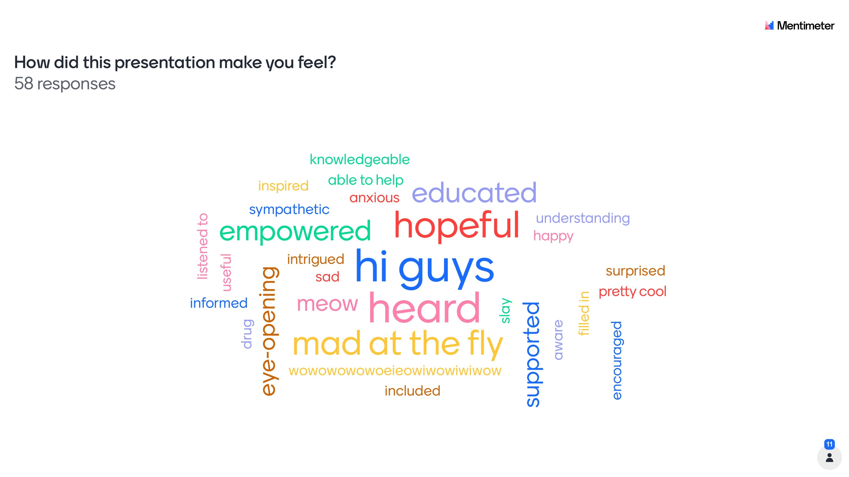
Notes:
The alcohol and other drugs peer research findings were shared with young people who took part in the survey, focus groups and interviews before we shared it with the wider community. This is how they felt.

Slide 43
What does the presentation say to you?
Young people are aware of what’s going on and know/have ideas on how to help. I like how young people were conducting and taking part in the research
It told me that more support is needed around drugs and alcohol in Shetland. It also pointed out the growing issue around peer pressure and young people.
I was unfortunately not surprised by any of the information about how rampant drug culture is in Shetland, although I’m incredibly hopeful and grateful that it is being discussed and researched by such loving and caring people.
Notes:
We asked young people what does the presentation say to you and the top three responses are on the slide.
They also said:
Its surprising how many young people use drugs to cope
Young folk are more aware of the drugs / alcohol issue than I thought – It’s a big issue
I can understand how youth feel about an important issue in cultural Shetland
That young people really care about challenging stigmas in Shetland
Young people are being listened to
Drug and alcohol culture in Shetland is worse than in Scotland
Drug and alcohol culture is bad in Shetland
It shows the extent of young people being aware how big the culture is
Says to me things have moved forward from young persons perspective, but not the wider community. They seem far more informed on the topic than it used to be, in a positive way

Slide 44
What is the most important messages that you got from the presentation?
Stigma around NOT drinking and peer pressure needs to be reduced
The main message I got from the presentation is that young people are willing to help and guide change, as well as adults, and a shift in stigma, culture and support outlets will help us all
It shouldn’t be entirely up to us to solve this issue
That more young people need more support when it comes to drug and alcohol use
Notes:
The top four responses to this question are listed above and young people also said:
More needs to be done
Stigmas need to be changed as the young people clearly see the issue
Wider support is needed
Peer pressure is a big thing
Fear mongering does not work
It’s a community problem not just young people
I have the power to make change that I did not know I had
The widespread use
Drug culture in Shetland is incredibly severe and worsening the more it’s left unaddressed, making all the more important and powerful to hear the voices of young people about the peer pressure from others and the example adults are in such a directive

