Slide 1
OPEN SPACE

Slide 2
Shannon Boston & Akira Foster
<Akira
& Shannon>
OPEN is youth led and invests in peer education and research with young people
We are Peer researchers employed for 9 months
The Ideas Fund is a grants programme run by the British Science Association and funded by Wellcome
Youth committee run by young people
Da Café set up
Notes:
OPEN is youth led and investing in peer education and research with young people.
Funded by the ideas fund backed by the British Science Association
We were employed from October 2021 to the end of June 2022, working 4 hours a week to research the need for a space for young people within Shetland
Working with researchers – We have been working with 2 professional researchers, Amy Calder and Jennifer Russel, to guide us on how to gather the data we needed and how to conduct research.
The youth committee meet every 6 weeks and they are a group of young people who are the driving force behind our research who guide us on the youth vision for what young people want to get out of it. It was the youth committee who were involved in applying for the funding from the ideas fund to hire peer researchers.
Shannon and Akira applied and were confirmed as the preferred candidates to the post, we have been consistent in working every week and creating great relationships with the professional researchers and young people throughout Shetland

Slide 3
Our Origins
Origins
Places are inaccessible and discriminatory
There is no action
Working with researchers
Notes:
Origins – Young people in Shetland have a lack of places they can have access too for any length of time, they have no place of their own to hang out or build connections.
Places are inaccessible – Places in Lerwick are not welcoming. Young people saying they have been chucked out of spaces and that staff members do not want them using community spaces. Young people feel they are not able to use spaces without paying and that spaces are unaffordable.
There is no action – With young people being chucked out of spaces and there being no designated space for young people, young people need a space that they feel belongs to them.
Identified through café nights we set up to see what the feedback from young people about needing a space. that Young people wanted a dedicated space on at the same time and same place every week which is when we decided to keep the space at the Olive tree on a Thursday every week. Our volunteer group, the youth committee was set up with the plan to create this safe dedicated space within Shetland and that is when the name Da Café was created to name the Thursday at the Olive tree

Slide 4
Our Achievements
Empowering young people
Listening and getting to know young people
Challenging professionals and community attitudes e.g. Bressay ferry
Being listened to
Engaging young people
Notes:
We have empowered young people – We want to empower young people to feel like they have sense of ownership and independence. To help young people build a community and to feel as though they belong, just now there isn’t a regular space. The only place that provides this regularly is us at the Olive Tree, one day a week.
Listening and getting to know young people – While we have been working we have been building relationships with young people, they have expressed interest in so many things and want to see things change for themselves and other young people. “I dunna want to see peerie bairns futures the same as our futures because just like we need more than we already have.”
Challenging professional and community attitudes – When the Shetland Times article about the Bressay ferry terminal about young people went online it was obvious that young people were being villainised for using the space. We commented on the article explaining that young people didn’t have a place to go which led to an interview with Shet News and Shetland Radio in which we spoke about the Olive Tree being a space for young people to use which led to a huge increase in numbers.
Being listened to – We have been doing focus groups with young people to get their views about issues they are having with spaces or changes they would want to happen. We also have had young people approach us in the Olive Tree to share their experiences.
Engaging young people – Speaking to young people on their level and not telling them they’re wrong. Explaining barriers to them rather than just saying no. Making young people feel listened too was as important to us as the engagement or findings.

Slide 5
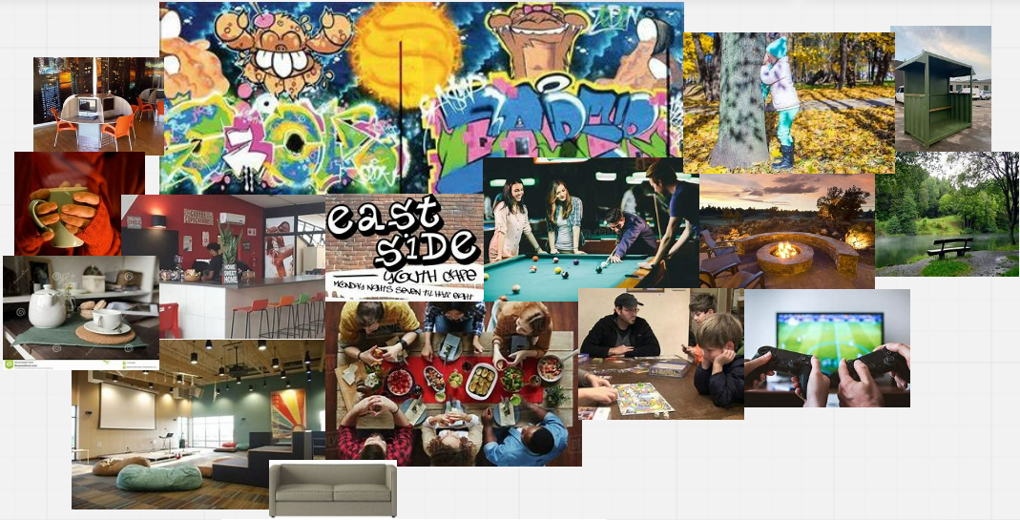
Core Questions
What is missing
Impact for community
What is needed
Notes:
Core question. What is missing? We asked young people what was missing in our Focus groups to identify the gaps for young people within existing places in Lerwick.
Core question. Impact for the community – Speaking to young people about the impact of the situation currently for them, their feelings of not being understood and a lack of options for them to do came up time after time When we spoke about the benefits that’s when we saw real enthusiasm for the young people having a sense of belonging, creating community spirit, more variety, an improvement to mental health and overall better life style if they had their own space.
Core question – What is needed? Young people answered what they felt was needed, ranging from a place they could decorate themselves, comfy seating, Wi-Fi, access to plug sockets, friendlier staff and more freedom or opportunity to take risks. They all felt that there wasn’t much opportunity for them to grow.

Slide 6
Method
Robust ethical youth link research approach
Mix of group/individual interviews, survey, online interactions
55 over 30s
Over 140 young people
Notes:
Method; Robust Ethical Youth research approach – In consultation with professional researchers we came up with the questions we wanted to ask and ways to get consent from young people to gather data. We used the questions within focus groups and also our survey that we put out around this work. We also played around with Padlet and added that onto the survey to give people more of a chance to interact.
Mix of group interviews, survey and online interaction – We did interviews with people over 30 to see what they had available when they were younger and benefits they had like setting them up with life skills or lifelong friends. We did focus groups with young people to find out how they feel and what they need. A survey that could be accessed online was put together to reach a wider audience which we got 66 responses from. We also used Padlet as another way to get people interacting. Padlet was essentially a website that we used to plot ideas for spaces on a map of Lerwick and we got some really creative ideas.
Through our interviews with the over 30s and a day with the public protection committee we have spoken to over 55 adults.
Between the Surveys, the Youth Committee the Olive Tree and Focus Groups we have spoken to over 140 young people.

Slide 7
Experience of over 30s
49 places over 30s met
49 places to meet – 7 over 30s interviews
17 places to meet identified by 28 under 25s in groups and individual
17 places under 25s meet
Notes:
– The older generations felt like they had so many options available to them growing up and that groups were cheaper and they had spaces that they could treat as their own.
49 places to meet from 7 people over 30.
28 under 25s focus group identified 17 places – use word cloud of places.

Slide 8
Benefit to them and Shetland
Independence
Confidence and self esteem
Relationship forming
Growing up and fitting in
Opportunity to take a lead
Physical health
Notes:
Benefit to them and Shetland;
– Identifying what a sense of ownership and belonging for young people can achieve. Independence, Confidence and self-esteem, forming relationships, growing up and fitting in, an opportunity to take a lead, improvement to physical health.

Slide 9
Attitudes towards Young people
Judged
Living out with their needs
Risk aversion harming to young people, no opportunity to experiment
Kids blow it for themselves
Not being allowed to fail
They’re online too much
Don’t understand their online community
Blaming social media
Notes:
Attitudes within the community that young people and adults have identified throughout our research have been very enlightening to us. Views such as young people living out with their means, young people are online too much or that adults don’t understand young people’s online community that they built throughout lockdown and before. There seems to be a lot of blame put on social media, one of our over 30s interviews said they felt that young people are not getting the same if much benefit at all with a lack of things on like they had and that it is largely to do with the whole social media thing.
Adults we spoke to could see that risk aversion is harming young people, they have no opportunities to experiment and that there is this stigma that kids blow it for themselves showing the judgements made on young people, we as a community give the impression to the young people that they aren’t allowed to fail. By not being given the opportunity to take risks.

Slide 10
Experience of under 25s
Kicked out
Unaffordable/ high cost
Judged
Unwelcome
Lonely
Bored
Unfriendly staff
Inaccessibility
Notes:
The experience of under 25s is that they feel unsatisfied with the spaces they can use in Lerwick, young people feel that things are unaffordable, high cost makes places less accessible and they find when they do buy something that they are moved along. They feel staff are unfriendly and kick them out of community spaces. Unwelcome, lonely, bored.

Slide 11
Impact
Feel excluded and judged
Feel unsafe
Harrowing to be thrown out
Not connected to community
Isolated / not fitting in
Notes:
The impact of the experiences for under 25s is that they feel excluded, judged and unsafe it is harrowing to be thrown out of a building. Young people feel they don’t fit in and are isolated meaning they don’t feel connected to the community

Slide 12
Ownership of a space for young people
Young people led
Cost price
Comfortable
Safe
Warm
Welcoming
Notes:
A space for young people where they feel would be best for them would be a space that they feel is safe and comfortable. The space should be reasonably prices or buying things at cost price. Freedom to be youth led with well managed volunteer and staff. Like they themselves have said ‘All most young people want is a place to gather without being constantly supervised.’ ‘An area that the young people run.’

Slide 13
Benefits
We can show we can do it
Mental health benefits
Life skills
Happier
Confidence
Notes:
Benefits
Young people have identified that a space that is their own would give them opportunities to gain life skills, connect and that they would be happier. They feel a space would keep them out of trouble and feel less trapped. They feel these benefits would lead to improved mental health for young people and an increase in confidence because they can show that they can do it.

Slide 14
Thank you

